Slide 1

Final Year Project Presentation
STAR: Student Task Assistant Resource
By Johnson Shogbaike

Slide 2

Overview
Here is an overview of what I will be going over today:
What is the STAR
Why I choose to make this application as my final year project
Similar apps and how my app would compare to them
Research
Architecture Diagram
Technologies and features
Timeline and where I am against that timeline
References & documentation

Slide 3


What is the STAR
The Student Task Assistant Resource or ‘STAR’ for short is essentially a todo list application aimed at making the life of college students easier, in regards to organisation.
I came up with this idea after thinking of what I would want as a student that could help me achieve the most optimal work output and study I could achieve in school.

Slide 4

Why did I choose this project
There are already many todo list and task tracking applications out there on the market that could help improve my organisation skills.
So why would I choose this project?
Well I looked at the problems I face as a student:
Tracking submissions
Tracking changes in the school timetable
remembering what classes I have on a certain day and what time those classes start.
Most todo list applications can track day to day task and even tasks that arent due for a long time. But in my opinion, putting all the lecture times into a todo app calendar and have to go into that app everyday so I could see when my classes are is quite toublesome.
So i wanted to make this app to make that process a little easier and more convenient

Slide 5
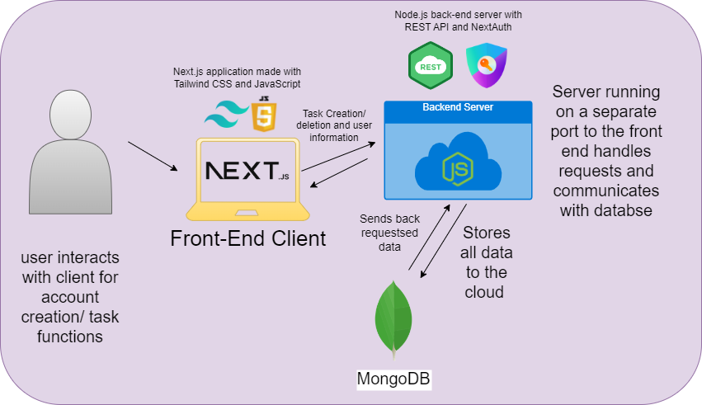
Architecture Diagram

Slide 6

Research
With this project, i did of research on react technologies and looked at online resources such as documentation and youtube videos
I have no prior experience with creating application front end and backend prior to this project, so most of the research i did was on the basics of this.
I looked at the potential for using apis like the Google Calendar’s API and OpenAI.
All of this was tracked with monday project planner in Kanban format
I researched helpful documentation on Next.js and Express and utilized these docs. throughout the creation of my project.
Notes:
For example, the useState hook. useState is used to track data or properties in these apps (i.e., it tracks todos). I will be using it in my application which will be shown later in the demo

Slide 7
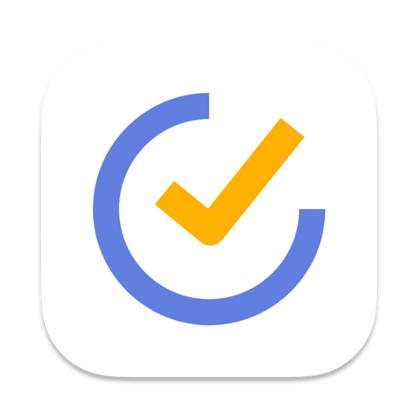
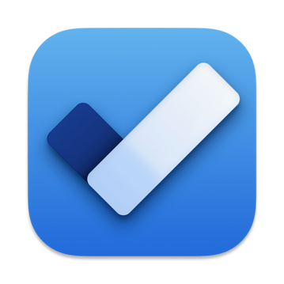

Similar Applications
Todoist
TickTick
Microsoft ToDo
Notes:
When researching the idea and feasability of making another todo app when there are already so many of these type of apps out there, i found that these three apps were the closest regards to the idea i had for my application. Especially Todoist, in the way that with other apps, such as Google calendar or zapier. TickTick is also close has features i want to add to my application too, such as reminders and alerts for projects and tasks. Microsoft ToDo has task prioritization which would be a nice feature to add into this app also.

Slide 8

How these apps compare to the STAR
All these applications have amazing features that make them different from eachother and unique.
But they are not aimed at students. They are more-so aimed at project groups
With STAR, It would be made with features that would be more appealing to students and very easy to use
Notes:
(Read first line of presentation)
But I felt as though these apps were not aimed at students, but rather people in the working world, that have shared projects and things like that.
Having to pay for a todolist app features is unappealing

Slide 9
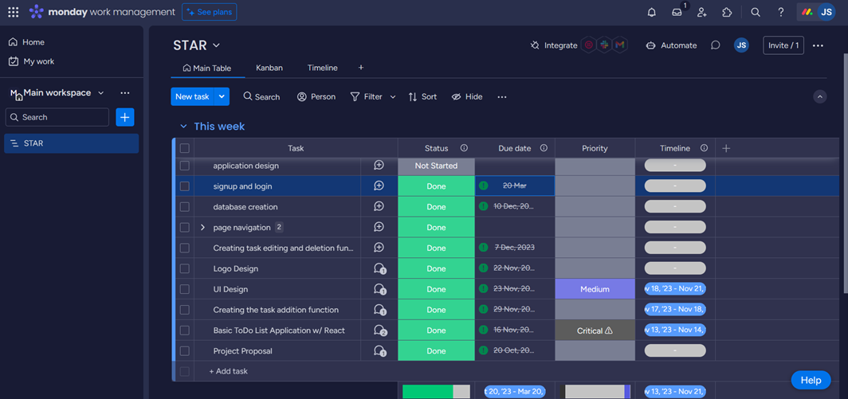
Project Planning
For my project, i used Monday project planner. This played a huge roll in m project

Slide 10

Features and Technologies
Features:
Adding, Editing, Deleting and Completing tasks.
Importing timetable, so the user can view their application on the app.
Task Prioritization & Status
Calendar
Categories.
User Creation and information protection
Session Creaion
Database Transaction
Technologies:
NextJS - TailwindCSS & JavaScript
Node.js - Express + REST API
Hooks - using useState to track state.
MongoDB Compass + Atlas
Notes:
Features:
1. this will be the basic functionality of the application
2. this is the feature i want to add to allow the students timetables to be easily integrated into the application
3. allows the user to set how urgent the task is and also set its status
4. the calendar will contain information on any events/ important dates added into the app.
5. the app will have categories of things added into the app tasks, events, project due dates)
Technologies:
1. I made the decision to move my application from basic react to nextjs to take advantage of the extra features that nextjs has to offer(Better server side rendering and other tools).
2. I am using tailwind css as it was highly recommended by web developers online and also recommended by a full stack developer i personally know. It is easier to understand and tidier.

Slide 11

Functionality
A user enters a unique username, email and password to signup. if the user does not already exist, the user will not be created
They are taken to the login page and must login. The user’s information on signup is saved to the databse and their password is protected
The login and signup both call to different routes. Once the login is verified (i.e., the user’s email exists and the password is correct”, the user is pushed to the main page.
A user can create a task, set a priority and put it under its appropriate category.
The tasks are stored in the database abd upon task update, the updates are saved to thet database also.
Tasks can also be deleted from the database when the trash icon beside each task is deleted.
A timetable in .xlsx or .xls format can be inputted into the app and is formatted and displayed in the app

Slide 12
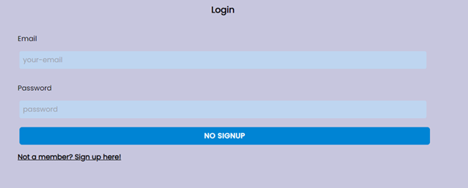
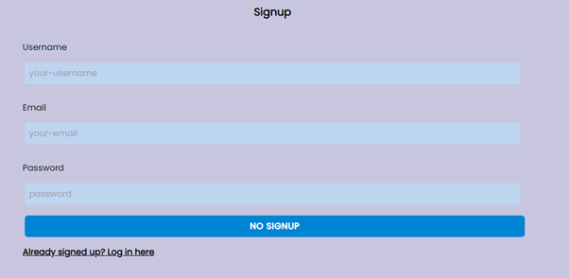
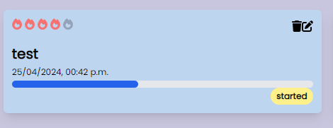
Results

Slide 13

Conclusion
With all the planning, work and research done throughout the whole year, i was able to create a tool that students can utilize in their every day school live
I learnt about th importance of planning, time managment and teamwork
I wish to further develop this project in the future by opening avenues for a mobile phone application

Slide 14

Thank you for listening

Slide 15
Resources Used with this project
Google Calendar API Overview (https://developers.google.com/calendar/api/guides/overview)
Notifications API (https://developer.mozilla.org/en-US/docs/Web/API/Notifications_API/Using_the_Notifications_API)
Next.js docs, https://nextjs.org/
Express.js documentation, https://developer.mozilla.org/en-US/docs/Learn/Server-side/Express_Nodejs
Open AI Documentation (https://platform.openai.com/docs/overview)

